Slide 1
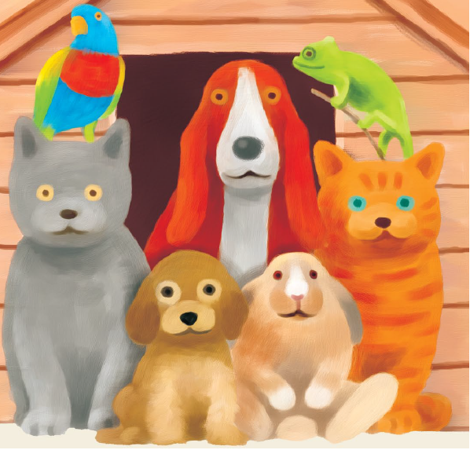
Animal Welfare
Recommended level: S1-3
Developed by English Language Education Section
Curriculum Development Institute
Education Bureau
October 2021

Slide 2
An Overview of the Learning Task
Learning objectives:
Content
To raise students’ awareness of animal welfare (e.g. animal abandonment, responsible pet ownership) through viewing and analysing different multimodal texts
To learn about the features of a leaflet
Language
To learn the vocabulary related to animal welfare
To give advice and make suggestions on how to be a responsible pet owner using imperatives
Values and Attitudes
To cultivate positive values and attitudes (e.g. respect for others, responsibility, commitment, care for others, empathy)

Slide 3
Lesson Outline
Sections | Content
1. What is animal welfare? | to brainstorm issues related to animal welfare through analysing some posters
2. Animal abandonment | to discuss the problem of animal abandonment through analysing a video to imagine and reflect on the feelings of abandoned animals by writing a soliloquy
3. Be a responsible pet owner | to discuss the things to consider before keeping a pet in a speaking task to identify the textual features of a leaflet
4. Promoting animal welfare at school | to create a leaflet to promote animal welfare at school

Slide 4

Section 1: What is animal welfare?

Slide 5
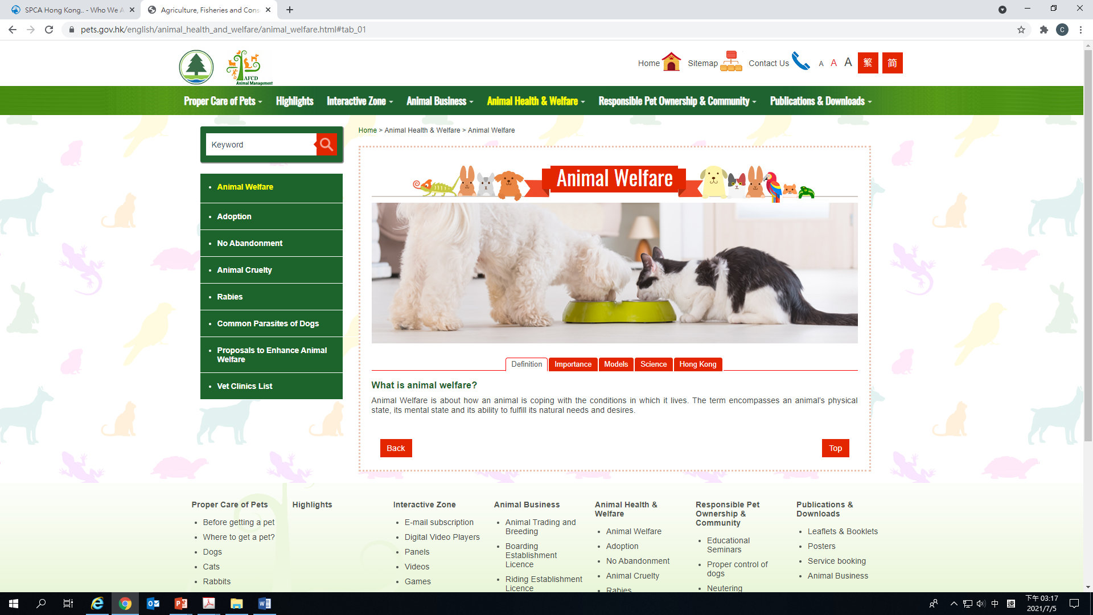
Knowing more about animal welfare
Definition from the Agriculture, Fisheries and Conservation Department (AFCD):
Animal Welfare is about how an animal is coping with the conditions in which it lives. The term encompasses an animal’s physical state, its mental state and its ability to fulfill its natural needs and desires.
What are the issues related to animal welfare?

Slide 6
Knowing more about animal welfare
- Picture analysis
Take a look at the pictures on the following pages, which are taken from the posters of the AFCD.
For each picture, answer the following questions:
  Describe what you see in the picture.
  What is the message conveyed in the picture?

Slide 7
Picture 1
  Describe what you see in the picture.
    The pets (dogs, cats and rabbit) are making a “stop” hand gesture.
    Their eyes look sincere and determined.
  2) What is the message conveyed in the
  picture?
    The pets are appealing to people to stop and think before keeping a pet.
    People should think twice before keeping a pet because it is a lifelong commitment. If people cannot give time and love to keep a pet, they should not keep one.
  Bonus question: What are the animals saying “no” to? Design a title for this picture.
    Abandoning animals, buying from illegal animal breeding farms, animal cruelty
    Possible titles: “Say NO to animal cruelty”, “Let’s stop abandoning animals”

Slide 8
Picture 1 (Original message)
Related issues:
Responsible pet ownership
Commitment
Respect for animals

Slide 9
Picture 2
Describe what you see in the picture.
A puppy who looks sad is being placed in a card box.
A person who is probably the pet owner is leaving the puppy behind and walking away.
  (Accept any reasonable answers.)
2) What is the message conveyed in the picture?
  Say no to animal abandonment
  Keeping a pet is a lifelong commitment. People should not abandon their pet.
  (Accept any reasonable answers.)
3) Bonus question: How would you feel if you were the dog? Complete the speech bubble.
  Please don’t leave me!
  Help me please!
  (Accept any reasonable answers.)
?

Slide 10
Picture 2
(Original message)
The offence of animal abandonment is liable to a fine of $10,000 and 6 months’ imprisonment
Related issues:
Animal abandonment
Responsible pet ownership
Respect for animals

Slide 11
Picture 3
(1)
  Describe what you see in the picture.
    The animals/cats and humans are gathering their hands together.
  2) What is the message conveyed in
  the picture?
    People should love their pets and be responsible pet owners so that their pets can rely on their owners. (Accept any reasonable answers.)
3) Bonus question:
Fill in the blanks in the title and speech bubble to highlight the key message of the picture.
(2)
(1) Love is being responsible
(2) Be a responsible pet owner
Adapted from: https://www.pets.gov.hk/english/publications_and_downloads/files/8.4.3%20Poster.pdf

Slide 12
Picture 3
(Original message)
Related issues:
Responsible pet ownership
Commitment
Respect for animals
Love and care for animals

Slide 13
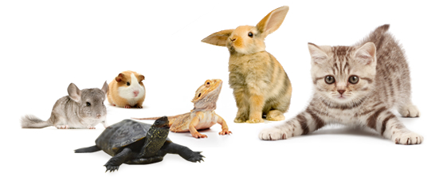
Section 2: Animal Abandonment

Slide 14
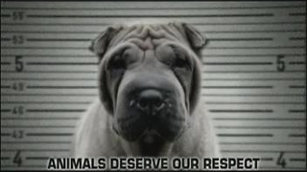
A) Video analysis
Video
Watch a video about animal cruelty and answer the questions on the worksheet.

Slide 15
A) Video analysis
How do you feel while watching the video? Why?
  Sad/upset/unhappy/gloomy/concerned
  The animals are suffering/mistreated.
  (Accept any reasonable answers.)
2. What techniques were used in the video to create such a feeling?
  The sad/emotional background music and black and white images created such a feeling.
  (Accept any reasonable answers.)

Slide 16
A) Video analysis
3. i) According to the video, why are animals being abandoned?
They become very old.
They are not loved by their owners anymore.
They are sick.
ii) What are the other reasons that people abandon their pets?
The pets need too much time and attention/have behavioral problems.
(Accept any reasonable answers.)

Slide 17
A) Video analysis
What is the key message of the video? Fill in each of the following blanks with one word.
The video is calling for r_______ for animals. We should fight against c______ to animals, for example, animal a______ and animal a_____________ .
respect
cruelty
abuse
abandonment

Slide 18
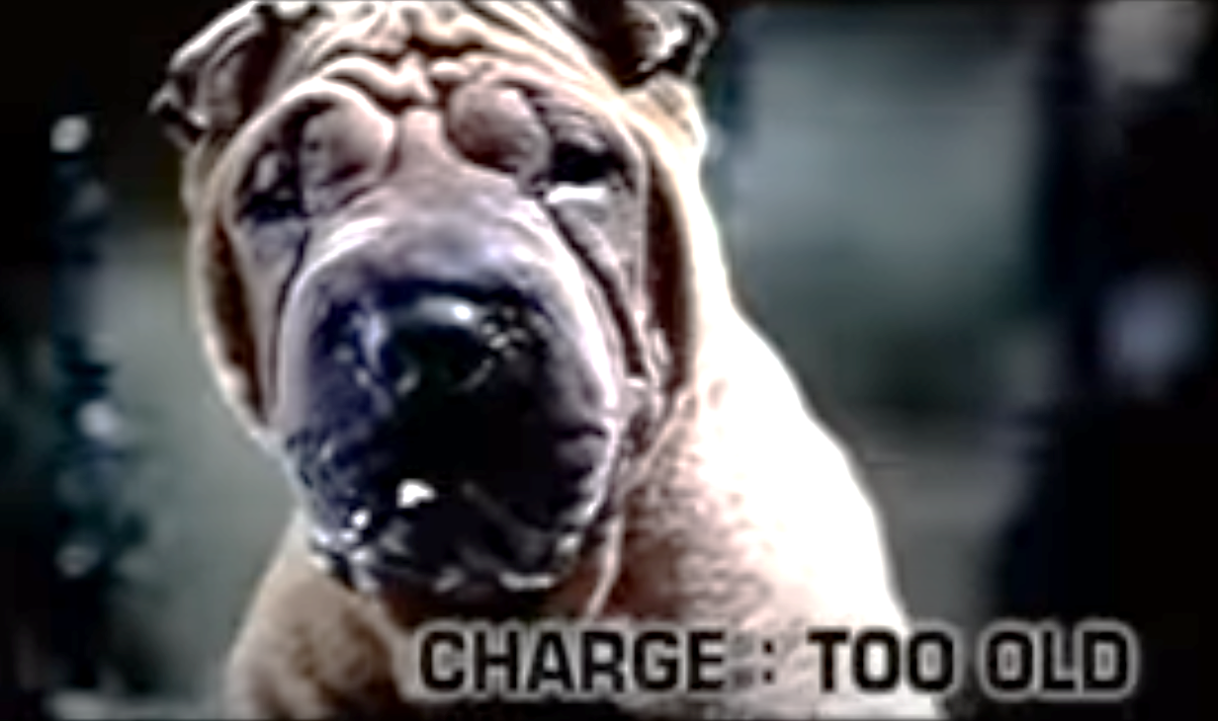
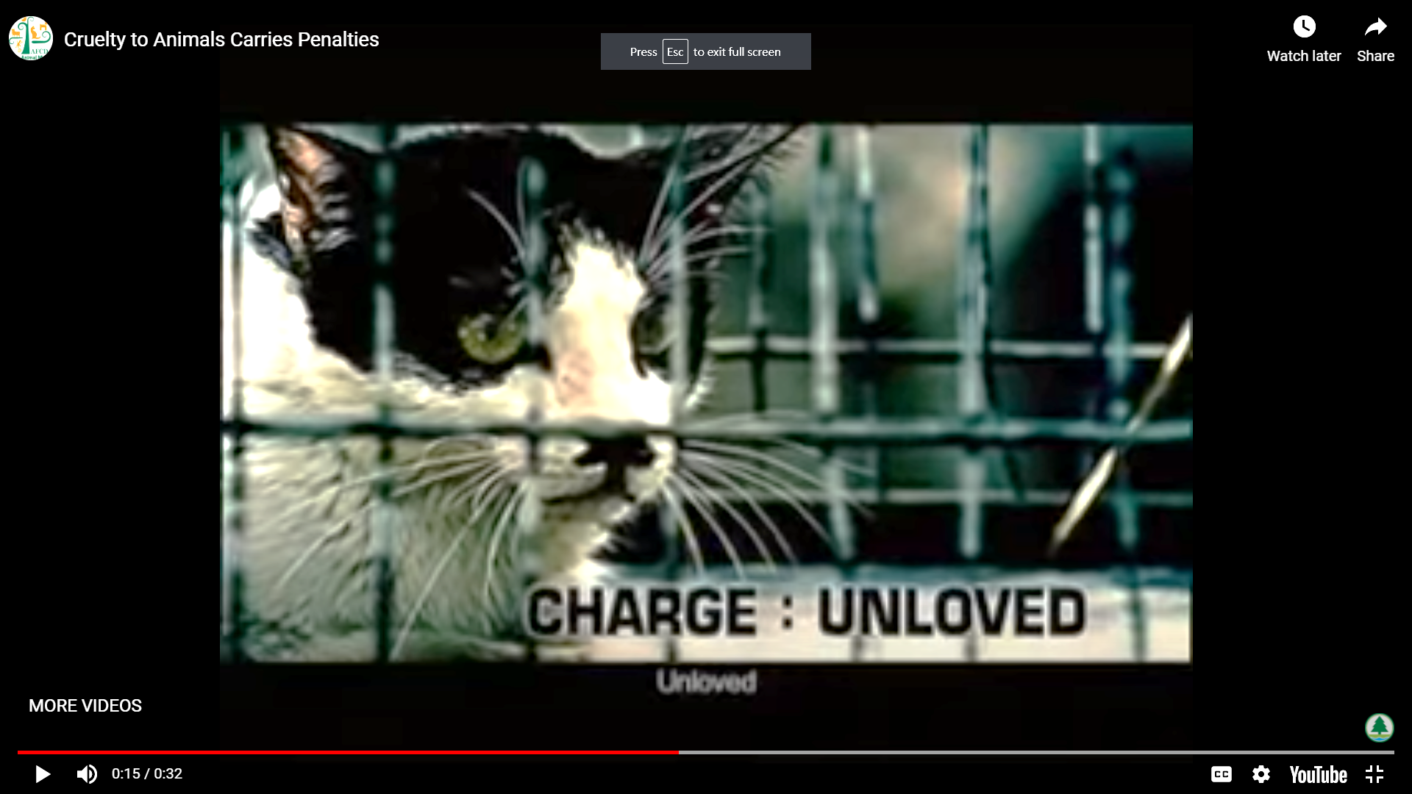
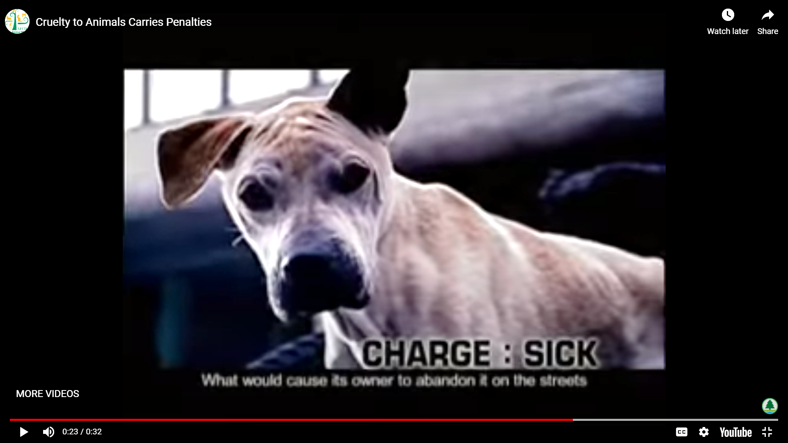
B) Soliloquy of an abandoned pet
Imagine you were an abandoned pet.
  How would you feel?
  What would you be thinking?
  What would you want to say to your owner?
Write a soliloquy to express your inner thoughts and feelings as an abandoned pet. You may begin with the line ‘That day, you left me alone in the street.’. A template is provided on the next slide.
Pair up with a classmate. Perform your soliloquy.
A soliloquy is a speech given to oneself when alone to reveal his/her inner thoughts and feelings.

Slide 19
Sample structure of a soliloquy
When I first met you, you said to me ‘ ______________________’.
I felt _________________ and I thought I was ________________________.
We had wonderful moments together:
We ___________________________.
We ___________________________.
We ___________________________.
Now I am ______________________________.
You said to me ‘__________________________’.
Although I feel ______________, I still want to tell you ‘__________________________’.
If I had a chance, I wish we could __________________________.
(feeling (adj.))
(past tense)
(feeling (adj.))

Slide 20
Section 3: Be a responsible pet owner

Slide 21
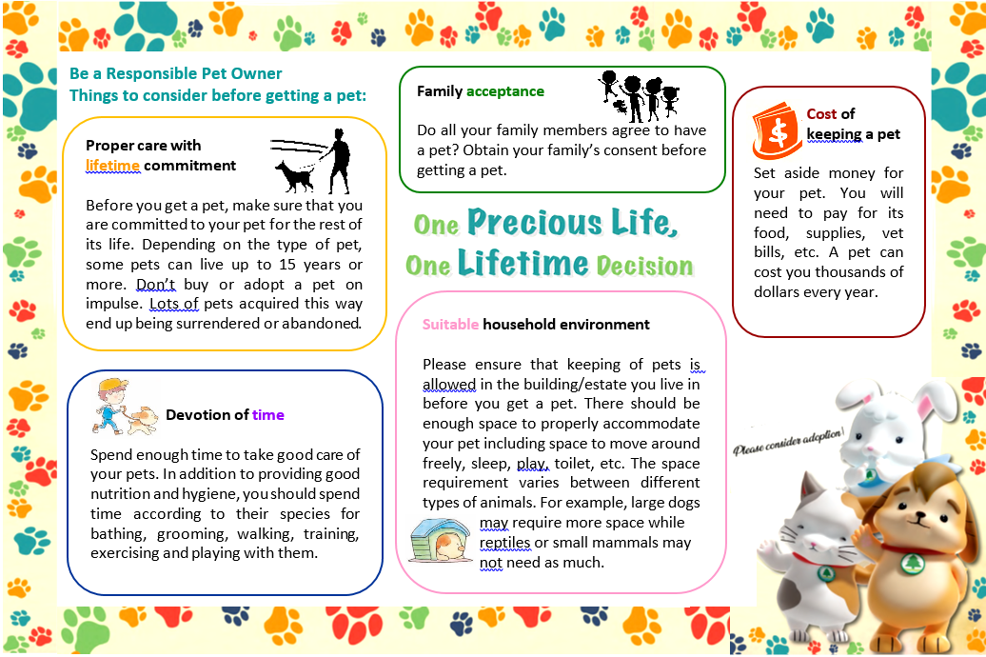
Study the leaflet below and complete a speaking task.

Slide 22
Things to consider before being a pet owner
A) Speaking Task – Group Discussion
Your class is discussing how to be a responsible pet owner. With reference to the leaflet ‘Be a responsible pet owner’ and your own knowledge, discuss the things to consider before having a pet in groups of four. You may want to talk about:
Things to consider before being a pet owner
Good qualities a pet owner should possess
How to promote responsible pet ownership in Hong Kong
Anything else you think is important

Slide 23
B) Understanding the text features of a leaflet
Study the leaflet on WS Page 4 and answer the following questions.
What is the title of the leaflet?
“One Precious Life, One Lifetime Decision”
2. How do you know it is a title?
  It is placed in the centre of the leaflet.
  The words are in bold.
  The font size is bigger.
3. What is the purpose of the leaflet?
  To inform readers of the things to consider before keeping a pet// To raise people’s awareness of being a responsible pet owner

Slide 24
3. i) What are the five things to consider before keeping a pet?
Proper care with lifetime commitment
Devotion of time
Family acceptance
Suitable household environment
Cost
ii) How are these messages being presented?
They are presented in the headings and are in bold.
The keywords are displayed in a different colour.

Slide 25
4. How do we address the readers in a leaflet?
“You”
Imperatives, modals and connectives are often used to present and organise information in leaflets.
Examples
Imperatives: “Obtain your family’s consent before getting a pet”
Modals: “can”
Connectives: “for example”
Identify more examples from the leaflet.
 | Language features | More examples
i) | Use of imperatives
ii) | Use of modals
iii) | Use of connectives
Set aside money for your pet.
//Spend enough time…
should//don’t
in addition to

Slide 26
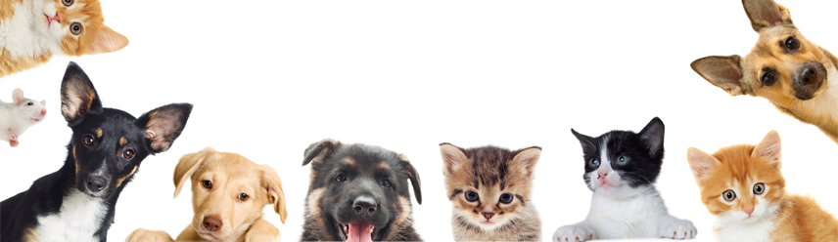
Section 4: Promoting animal welfare at school

Slide 27
Designing a Leaflet
With reference to what you have learnt about animal welfare and the features of a leaflet in Sections 1-3, design a leaflet to be displayed in your school to raise awareness of animal welfare. You may include some of the ideas below:
What is animal welfare? Why is it important?
How to be a responsible pet owner?
How can students take part in promoting animal welfare?
What activities can be organised to promote animal welfare at school?

Slide 28
Post-writing self-reflection
Put a ‘✓’ for the item(s) that you can do.
 |  | Yes (✓) | No(✓)
Content
 | I have included a catchy title.
2. | I have included relevant themes on animal welfare (e.g. responsible pet ownership, fight against animal abuse and animal abandonment).
3. | I have given clear elaborations and concrete suggestions on how to raise awareness of animal welfare at school.
Language
4. | I can use modals (e.g. “can”, “should”, “will”) to make suggestions, and express ability, prohibition and future possibility.
5. | I can use imperatives to give instructions and express prohibition.
6. | I can use connectives to link ideas coherently.
Organisation
7. | I have made use of clear headings and subheadings.
8. | I can create and present information in different forms, including texts and images.
9. | I have used different colours and font types to help convey the key messages.

Slide 29
Acknowledgements
Information and images/pictures in this set of materials are taken from the following resources, by courtesy of the Agriculture, Fisheries and Conservation Department (www.pets.gov.hk).
PPT slides p.7-8 (Picture 1)
Adapted from: https://www.pets.gov.hk/english/proper_care_of_pets/files/pets_are_for_life.pdf
PPT slides p.9-10 (Picture 2)
Adapted from: https://pets.gov.hk/english/publications_and_downloads/files/Poster_NoAbandonment.pdf
PPT slides p.11-12 (Picture 3)
Adapted from: https://www.pets.gov.hk/english/publications_and_downloads/files/8.4.3%20Poster.pdf
PPT slide p.14 (Video) https://youtu.be/D7dTvrt2phk
PPT slide p. 21 (Leaflet)
Adapted from: https://www.pets.gov.hk/english/publications_and_downloads/files/OnePreciousLife_Leaflet.pdf

